Slide 1
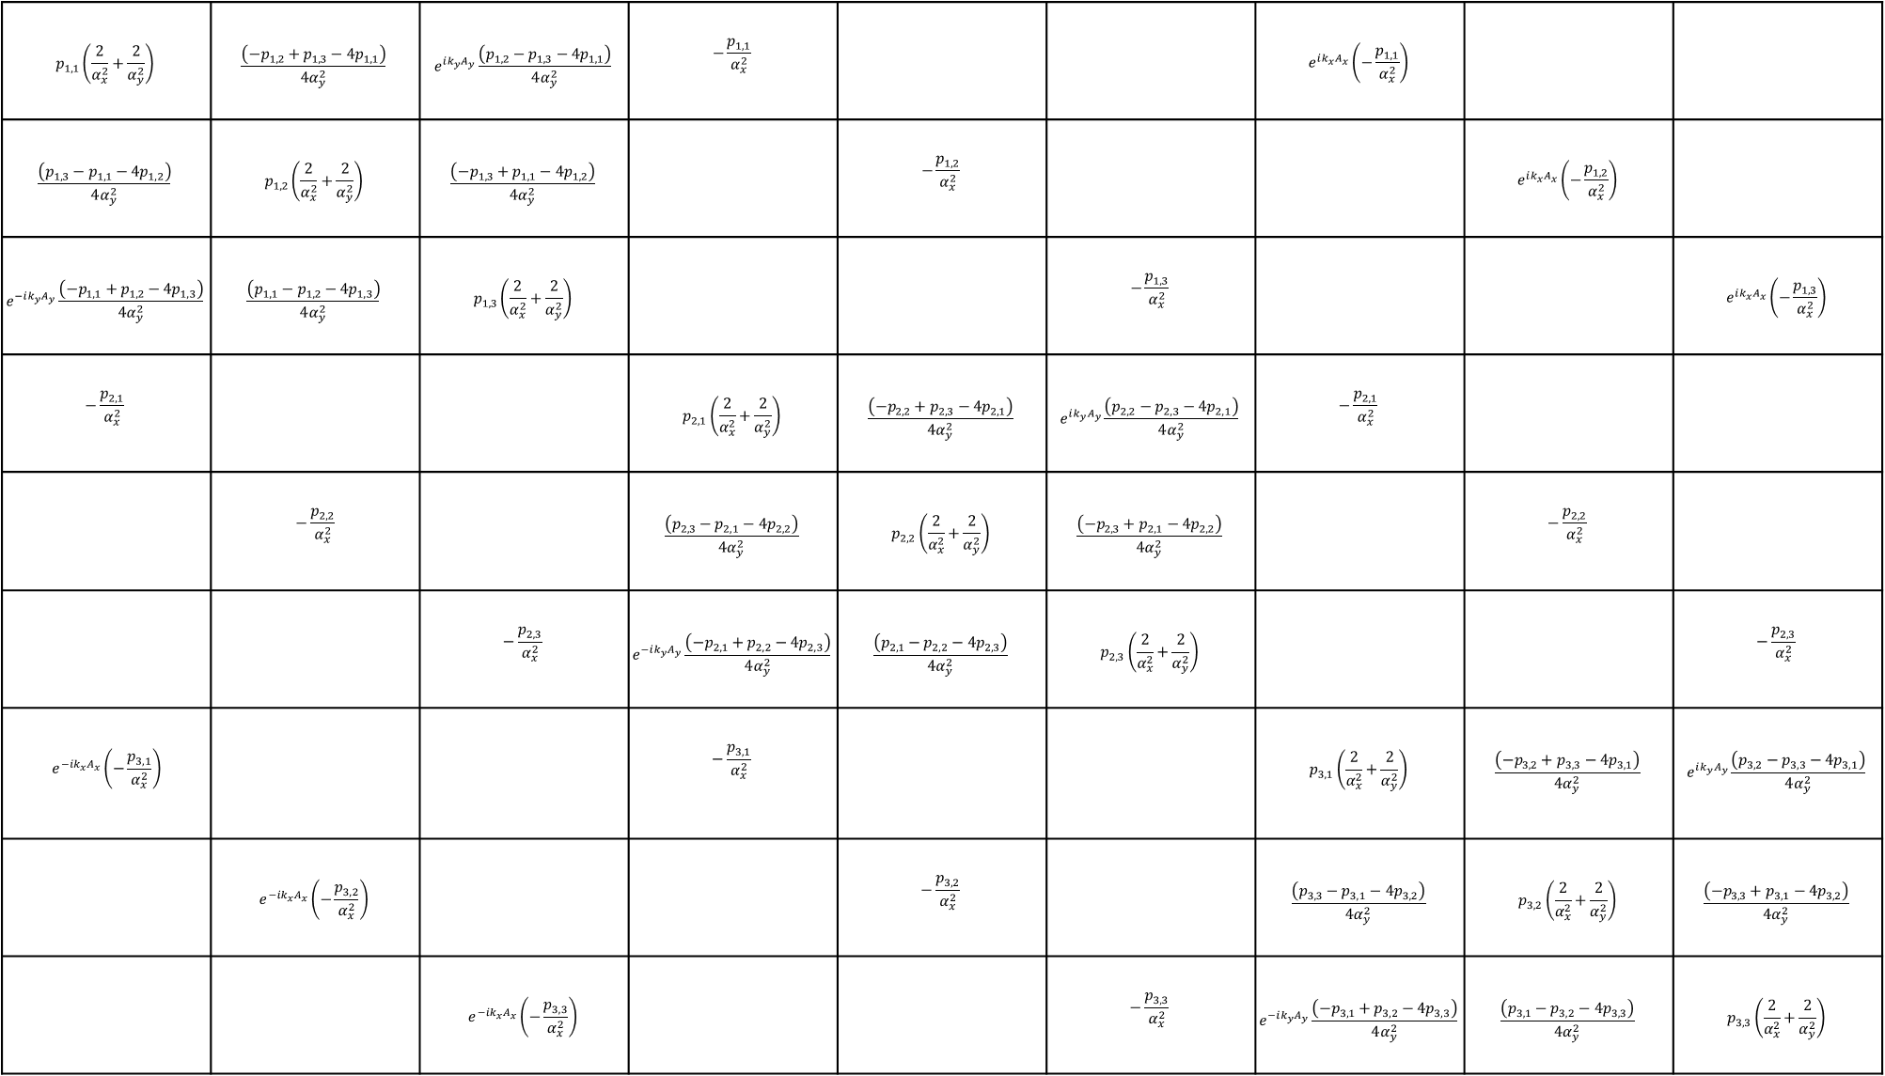
(1, 1)
(1, 2)
(1, 3)
(1, 4)
(1, 5)
(1, 6)
(1, 7)
(1, 8)
(1, 9)
$$p_{1, 1}\left(\frac{2}{α_{x}^{2}}+\frac{2}{α_{y}^{2}}\right)$$ | $$\frac{\left(−p_{1, 2}+p_{1, 3}−{4p}_{1, 1}\right)}{4α_{y}^{2}}$$ | $$e^{ik_{y}A_{y}}\frac{\left(p_{1, 2}−p_{1, 3}−{4p}_{1, 1}\right)}{4α_{y}^{2}}$$ | $$−\frac{p_{1, 1}}{α_{x}^{2}}$$ |  |  | $$e^{ik_{x}A_{x}}\left(−\frac{p_{1, 1}}{α_{x}^{2}}\right)$$
$$\frac{\left(p_{1, 3}−p_{1, 1}−{4p}_{1, 2}\right)}{4α_{y}^{2}}$$ | $$p_{1, 2}\left(\frac{2}{α_{x}^{2}}+\frac{2}{α_{y}^{2}}\right)$$ | $$\frac{\left(−p_{1, 3}+p_{1, 1}−{4p}_{1, 2}\right)}{4α_{y}^{2}}$$ |  | $$−\frac{p_{1, 2}}{α_{x}^{2}}$$ |  |  | $$e^{ik_{x}A_{x}}\left(−\frac{p_{1, 2}}{α_{x}^{2}}\right)$$
$$e^{−ik_{y}A_{y}}\frac{\left({−p}_{1, 1}+p_{1, 2}−{4p}_{1, 3}\right)}{4α_{y}^{2}}$$ | $$\frac{\left(p_{1, 1}−p_{1, 2}−{4p}_{1, 3}\right)}{4α_{y}^{2}}$$ | $$p_{1, 3}\left(\frac{2}{α_{x}^{2}}+\frac{2}{α_{y}^{2}}\right)$$ |  |  | $$−\frac{p_{1, 3}}{α_{x}^{2}}$$ |  |  | $$e^{ik_{x}A_{x}}\left(−\frac{p_{1, 3}}{α_{x}^{2}}\right)$$
$$−\frac{p_{2, 1}}{α_{x}^{2}}$$ |  |  | $$p_{2, 1}\left(\frac{2}{α_{x}^{2}}+\frac{2}{α_{y}^{2}}\right)$$ | $$\frac{\left(−p_{2, 2}+p_{2, 3}−{4p}_{2, 1}\right)}{4α_{y}^{2}}$$ | $$e^{ik_{y}A_{y}}\frac{\left(p_{2, 2}−p_{2, 3}−{4p}_{2, 1}\right)}{4α_{y}^{2}}$$ | $$−\frac{p_{2, 1}}{α_{x}^{2}}$$
 | $$−\frac{p_{2, 2}}{α_{x}^{2}}$$ |  | $$\frac{\left(p_{2, 3}−p_{2, 1}−{4p}_{2, 2}\right)}{4α_{y}^{2}}$$ | $$p_{2, 2}\left(\frac{2}{α_{x}^{2}}+\frac{2}{α_{y}^{2}}\right)$$ | $$\frac{\left(−p_{2, 3}+p_{2, 1}−{4p}_{2, 2}\right)}{4α_{y}^{2}}$$ |  | $$−\frac{p_{2, 2}}{α_{x}^{2}}$$
 |  | $$−\frac{p_{2, 3}}{α_{x}^{2}}$$ | $$e^{−ik_{y}A_{y}}\frac{\left({−p}_{2, 1}+p_{2, 2}−{4p}_{2, 3}\right)}{4α_{y}^{2}}$$ | $$\frac{\left(p_{2, 1}−p_{2, 2}−{4p}_{2, 3}\right)}{4α_{y}^{2}}$$ | $$p_{2, 3}\left(\frac{2}{α_{x}^{2}}+\frac{2}{α_{y}^{2}}\right)$$ |  |  | $$−\frac{p_{2, 3}}{α_{x}^{2}}$$
$$e^{−ik_{x}A_{x}}\left(−\frac{p_{3, 1}}{α_{x}^{2}}\right)$$ |  |  | $$−\frac{p_{3, 1}}{α_{x}^{2}}$$ |  |  | $$p_{3, 1}\left(\frac{2}{α_{x}^{2}}+\frac{2}{α_{y}^{2}}\right)$$ | $$\frac{\left(−p_{3, 2}+p_{3, 3}−{4p}_{3, 1}\right)}{4α_{y}^{2}}$$ | $$e^{ik_{y}A_{y}}\frac{\left(p_{3, 2}−p_{3, 3}−{4p}_{3,1}\right)}{4α_{y}^{2}}$$
 | $$e^{−ik_{x}A_{x}}\left(−\frac{p_{3, 2}}{α_{x}^{2}}\right)$$ |  |  | $$−\frac{p_{3, 2}}{α_{x}^{2}}$$ |  | $$\frac{\left(p_{3, 3}−p_{3, 1}−{4p}_{3, 2}\right)}{4α_{y}^{2}}$$ | $$p_{3, 2}\left(\frac{2}{α_{x}^{2}}+\frac{2}{α_{y}^{2}}\right)$$ | $$\frac{\left(−p_{3, 3}+p_{3, 1}−{4p}_{3, 2}\right)}{4α_{y}^{2}}$$
 |  | $$e^{−ik_{x}A_{x}}\left(−\frac{p_{3, 3}}{α_{x}^{2}}\right)$$ |  |  | $$−\frac{p_{3, 3}}{α_{x}^{2}}$$ | $$e^{−ik_{y}A_{y}}\frac{\left({−p}_{3, 1}+p_{3, 2}−{4p}_{3, 3}\right)}{4α_{y}^{2}}$$ | $$\frac{\left(p_{3, 1}−p_{3, 2}−{4p}_{3, 3}\right)}{4α_{y}^{2}}$$ | $$p_{3, 3}\left(\frac{2}{α_{x}^{2}}+\frac{2}{α_{y}^{2}}\right)$$
(2, 1)
(2, 2)
(2, 3)
(2, 4)
(2, 5)
(2, 6)
(2, 7)
(2, 8)
(2, 9)
(3, 1)
(3, 2)
(3, 3)
(3, 4)
(3, 5)
(3, 6)
(3, 7)
(3, 8)
(3, 9)
(4, 1)
(4, 2)
(4, 3)
(4, 4)
(4, 5)
(4, 6)
(4, 7)
(4, 8)
(4, 9)
(5, 1)
(5, 2)
(5, 3)
(5, 4)
(5, 5)
(5, 6)
(5, 7)
(5, 8)
(5, 9)
(6, 1)
(6, 2)
(6, 3)
(6, 4)
(6, 5)
(6, 6)
(6, 7)
(6, 8)
(6, 9)
(7, 1)
(7, 2)
(7, 3)
(7, 4)
(7, 5)
(7, 6)
(7, 7)
(7, 8)
(7, 9)
(8, 1)
(8, 2)
(8, 3)
(8, 4)
(8, 5)
(8, 6)
(8, 7)
(8, 8)
(8, 9)
(9, 1)
(9, 2)
(9, 3)
(9, 4)
(9, 5)
(9, 6)
(9, 7)
(9, 8)
(9, 9)

